Slide 1


Slide 2

Agile Testing in the Real World

Slide 3

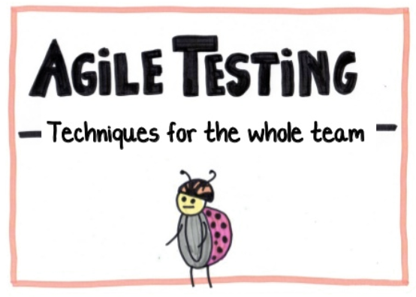
Agile Testing in the Real World
There are lots of books, articles, and webinars about how great Agile is
However, those often describe purist approaches that adhere to the Agile Manifesto
This tech talk isn’t about that pure world, but rather about what happens when Agile theory meets the real world
In the real world, companies are coming up with interesting and creative ways to adapt Agile practices
This creates various opportunities, challenges, risks, and benefits for testing and quality
In this tech talk, we examine those…

Slide 4
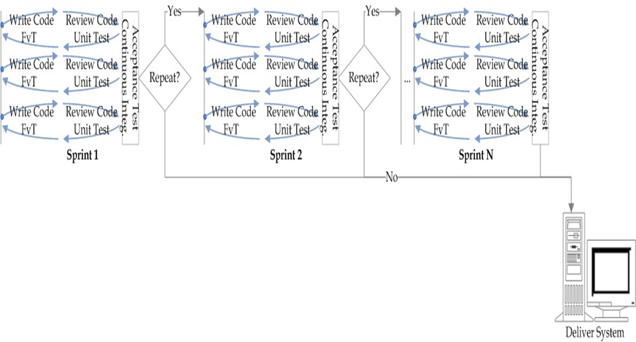

What Does Agile Look Like?

Slide 5
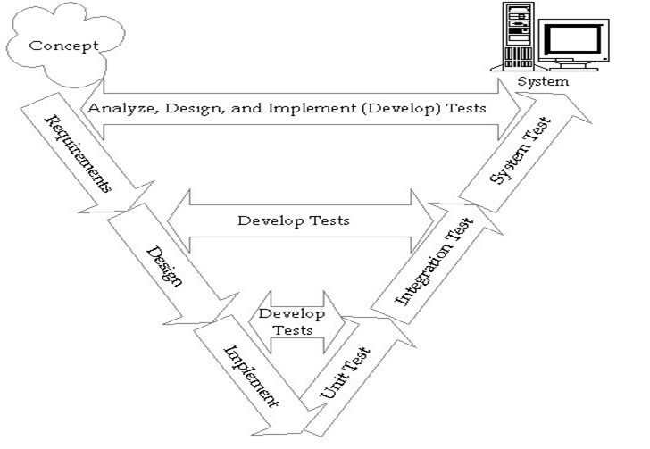

Agile Is the Opposite of What?

Slide 6
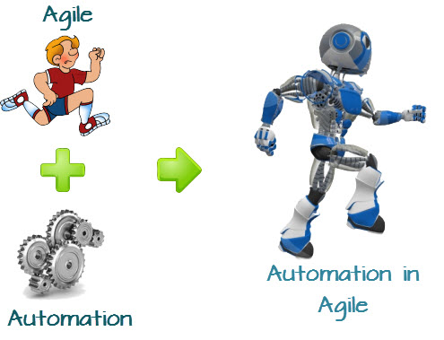
Agile Test Tools
Good stuff, mostly free
x-Unit
Jenkins
Cucumber
Ruby
Selenium
Fitnesse
Plus various static code analysis and code coverage tools…
Not all is good
Jira and Rally are not designed by or for testers. Often used as bug and test management tools

Slide 7
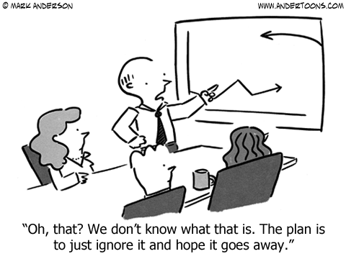
Agile Test Metrics
Tests completed
Bugs found, bugs fixed, and bug remaining open (which can block user story "Doneness")
Some organizations don’t measure bugs during sprints (loss of visibility)
Velocity of sprint (user stories completed)
Code coverage achieved

Slide 8


Agile Testing Challenges
Volume and speed of change
Remaining effective in short iterations
Increased regression risk
Inconsistent or inadequate unit testing
Poor, changing, and missing tests
Meeting overload
Over-commitment in the sprints
Timing of performance testing

Slide 9
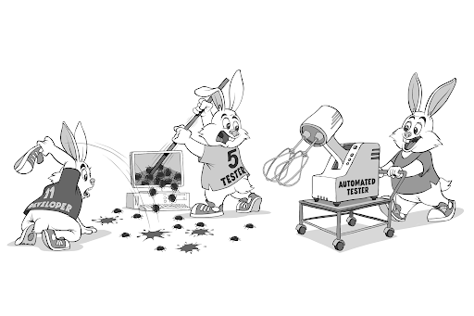

Agile Testing Opportunities
Automated unit testing
Static code analysis
Code coverage
Continuous integration
Automated functional testing
Requirements (user story) reviews
Control of technical debt (via “fix bugs first”)

Slide 10

Role of QA Testers in Agile Project
Traditional QA Testing Role
Advantage and Disadvantage of Traditional QA Organization
Develop an Agile Testing Approach
The Role of QA Testing in an Agile environment
Advantage | Disadvantage
Objectivity and independence of the testing function | Limited understanding of the software being tested
Focus on the discipline of QA testing | Responsibility for QA is diffuse and ambiguous

Slide 11

Tester Skill Implications of Agile
The trend is towards requiring programming skill in testers
This trend seems to be expanding worldwide and this is especially important on Agile projects
Not only is programming skill needed, but test automation skills are also essential
Another important issue is personality
Extroverts generally like Agile because of the emphasis on talking over analysis
Introverts often find Agile harder to adapt to

Slide 12
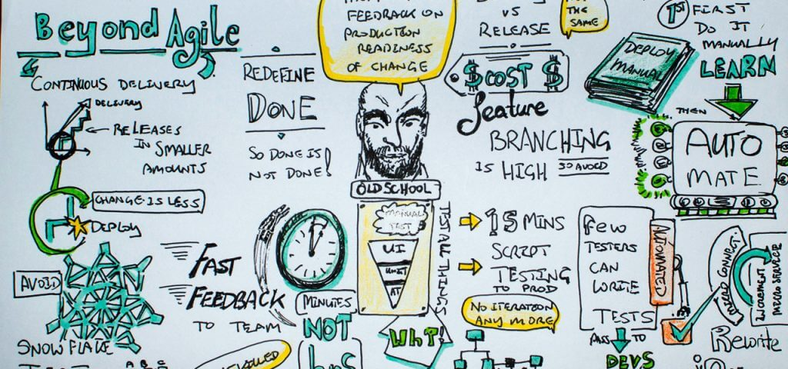
Conclusions
Agile lifecycles are distinct from sequential lifecycles, in ways that affect testing and quality
A variety of test tools are available for Agile (and non-Agile) teams
Metrics programs may be taking a step backward in Agile projects
Agile lifecycles create testing challenges and opportunities
Agile lifecycles have strong implications for tester skills
Agile’s effect on quality remains unclear

Slide 13
T H A N K Y O U !

